Slide 1
NAAN MUDHALVAN PHASE 5
BY
POOVARASAN G
REG NONO:211921104012

Slide 2
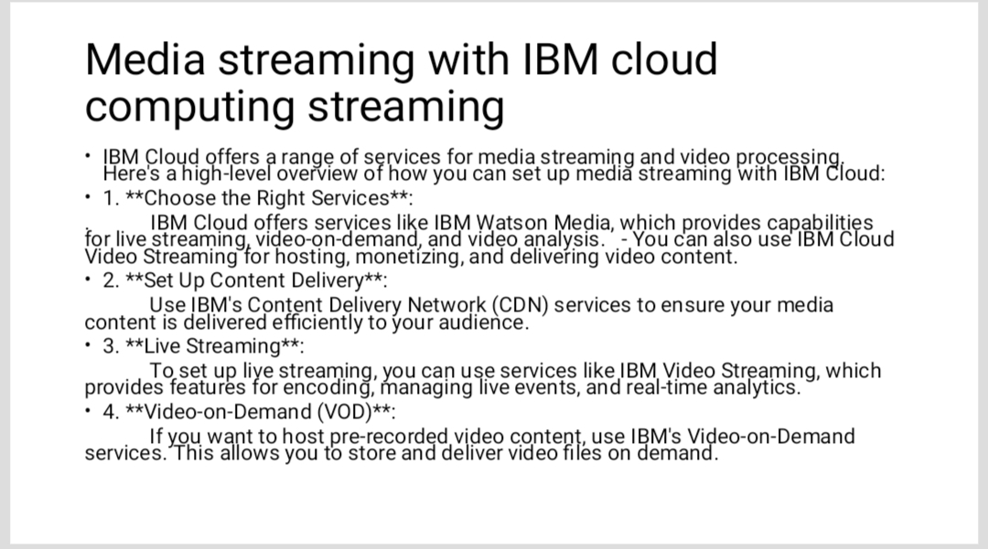

Slide 3
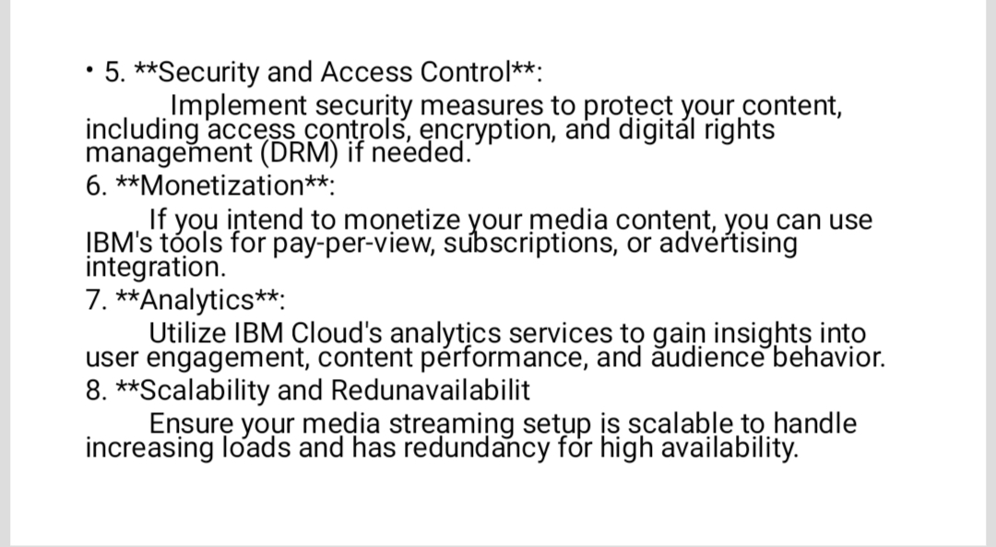

Slide 4
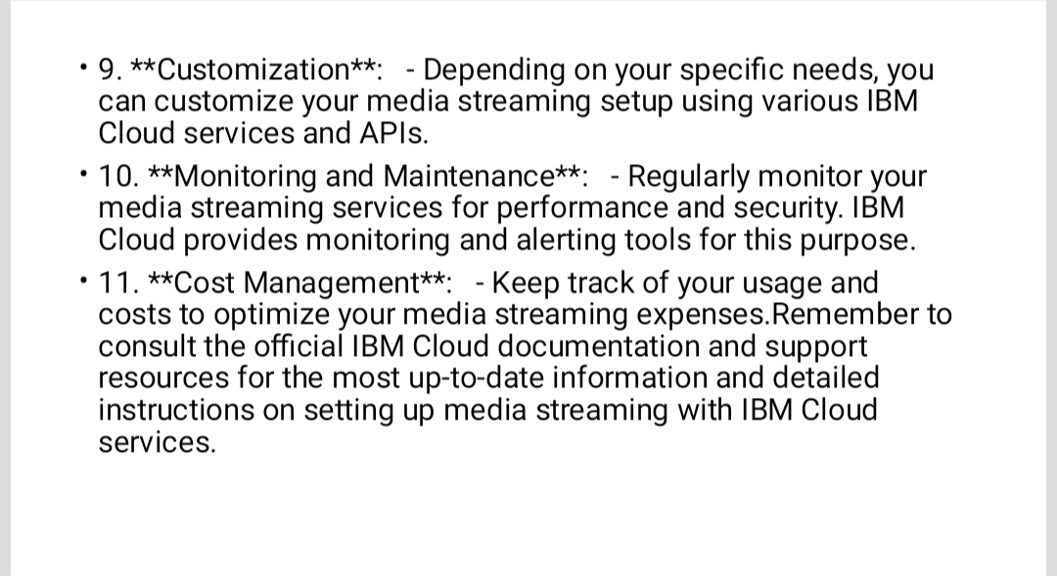

Slide 5
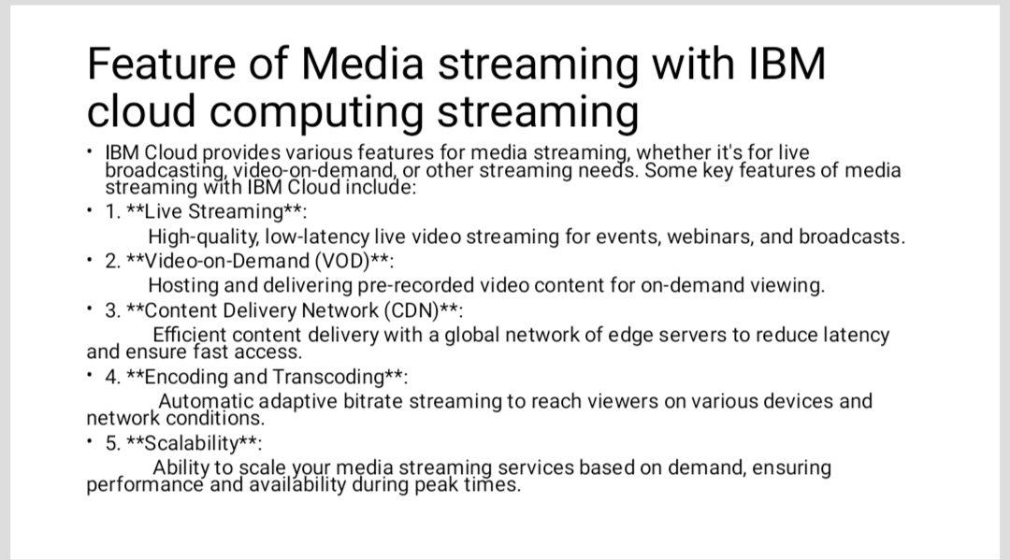

Slide 6
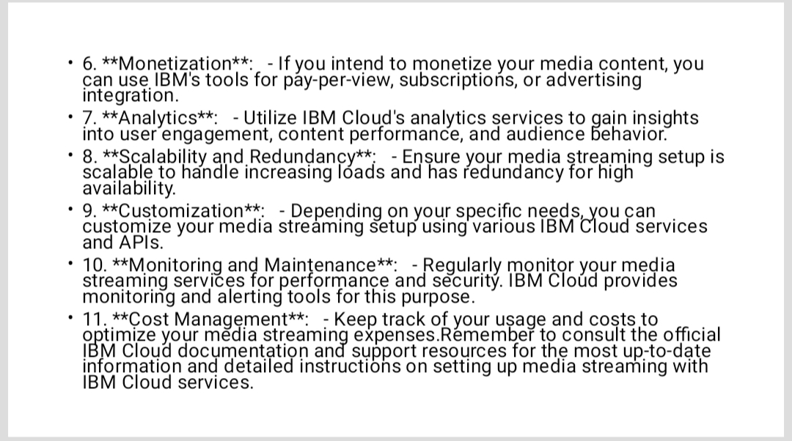

Slide 7


Slide 8
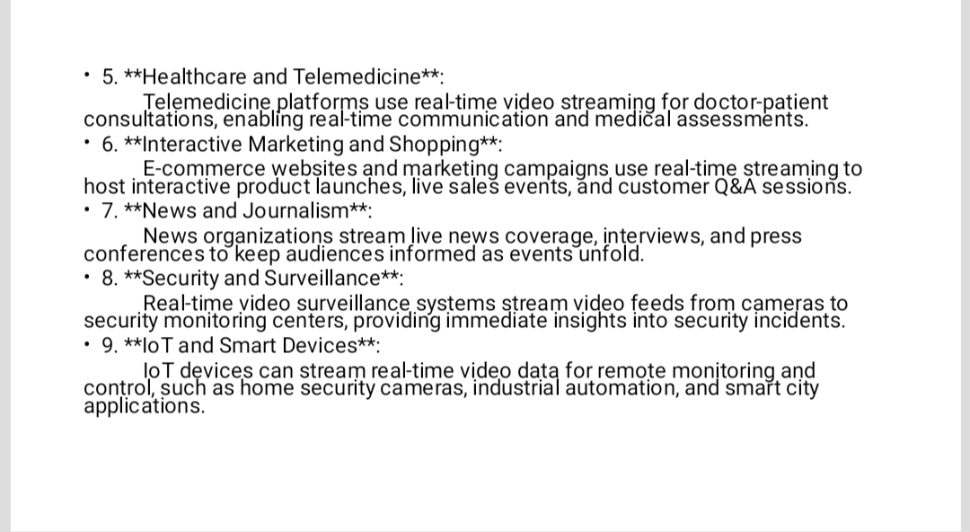

Slide 9
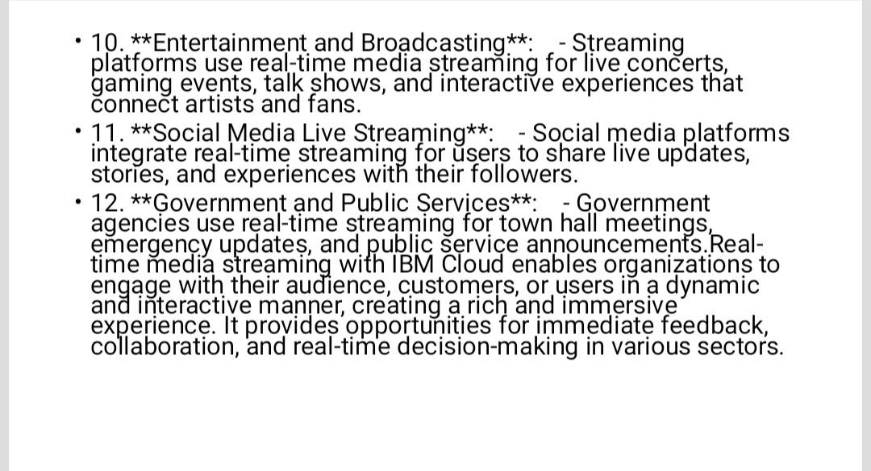

Slide 10
Thank You

